Slide 1
Energy Efficiency Programs
Jasmine King-Bush – Manager, Energy Efficiency Programs

Slide 2
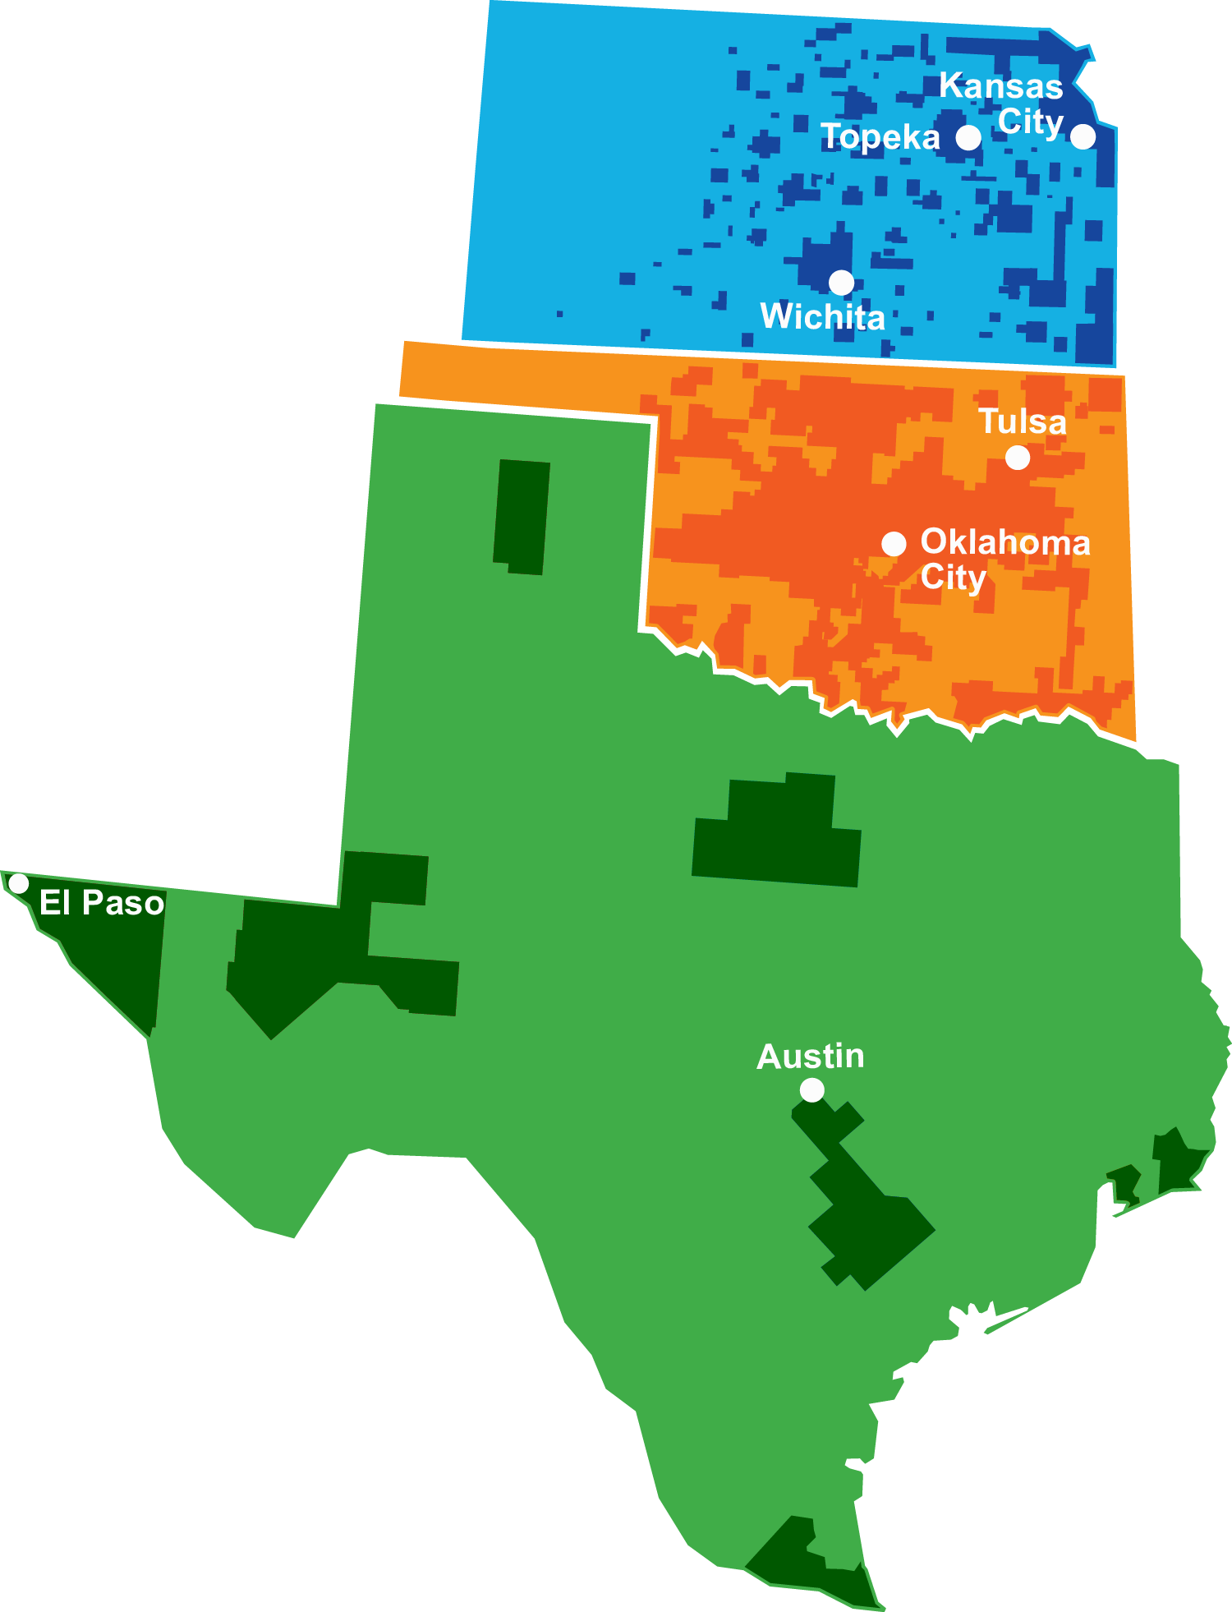
ONE Gas Overview
Our Divisions
100% regulated natural gas utility
2.3 million customers in Kansas,
Oklahoma and Texas
Kansas
71% market share, the largest in Kansas
Oklahoma
3,800 employees
44,500 miles of pipeline
Texas
88% market share, the largest in Oklahoma
One of the largest publicly traded natural gas distribution companies
13% market share, the third largest in Texas
More than 100 years of experience
in the natural gas industry
Notes:
Stats as of Dec. 31, 2022; consistent with current Annual Report.

Slide 3
Energy Efficiency Program Overview
Kansas Gas Service
Energy Efficiency education and behavior modification tips
Oklahoma Natural Gas
One Energy Efficiency Program available to ALL residential and commercial natural gas sales customers
Texas Gas Service
Two Energy Efficiency Programs available to roughly 46% of all residential and commercial natural gas sales customers

Slide 4
Program Focus Areas
Rebates/Incentives Offered
High-efficiency appliance rebates
High-efficiency system rebates
Weatherization
Energy management
Appliance replacement
Residential Retrofit
Commercial D/I, DIY, SEM
New Construction
Low-Income/Free Equipment

Slide 5
Energy Efficiency Program Partnerships
Regulatory Bodies
Builders/Developers
Other Utilities
Industry Organizations
Community Advocacy Groups
Trade Partners

Slide 6
Texas Gas Service
Energy Efficiency Overview
Process/program improvement
Program alignment
Support corporate, local and regional conservation goals
What does the future look like?
Identify areas ripe for program growth

Slide 7
Thank you for joining

