Slide 1
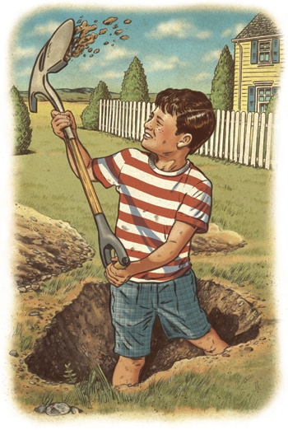
An Underground Movement:
Geothermal Heat Pumps in Texas

Slide 2
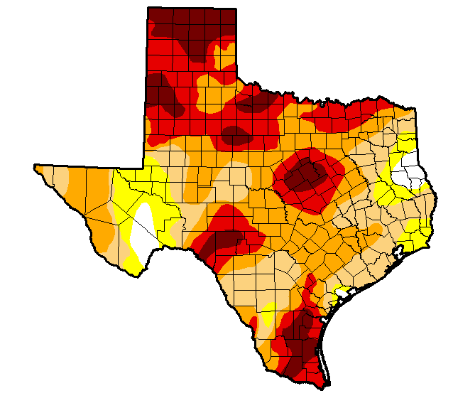
Summer
When it’s Hotter than Billy Blue Blazes in Texas…

Slide 3
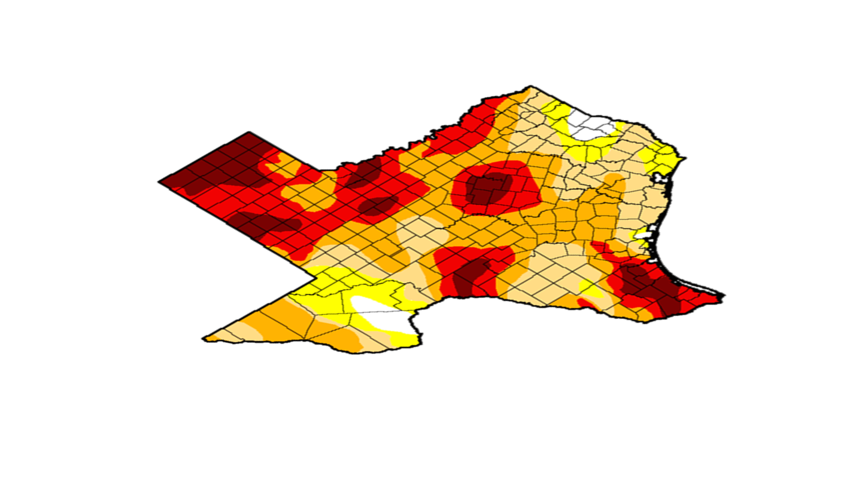
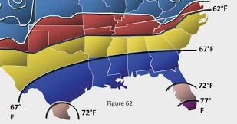
It’s 62°F – 72°F
30 feet below your feet.

Slide 4
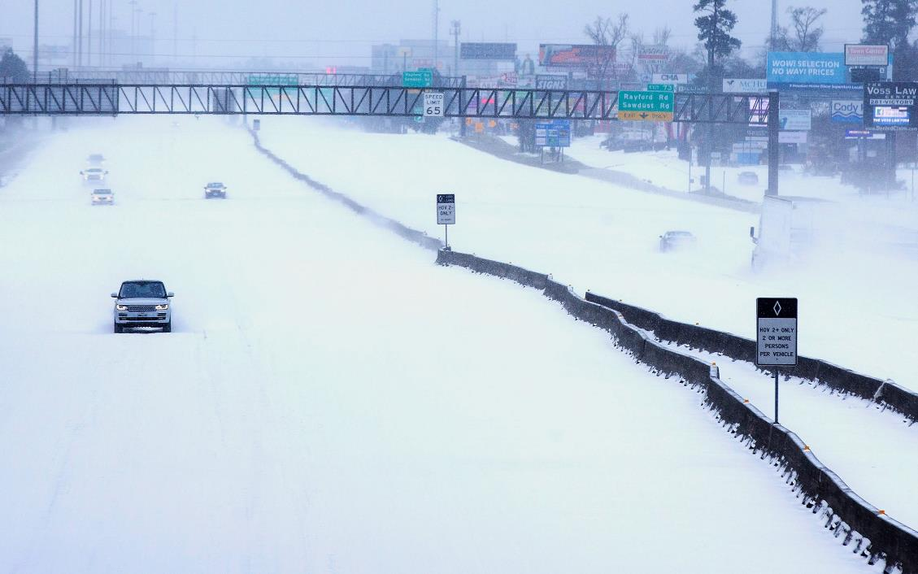
Winter
When Houston is snowed in…

Slide 5
It’s 62°F – 72°F
30 feet below your feet.

Slide 6
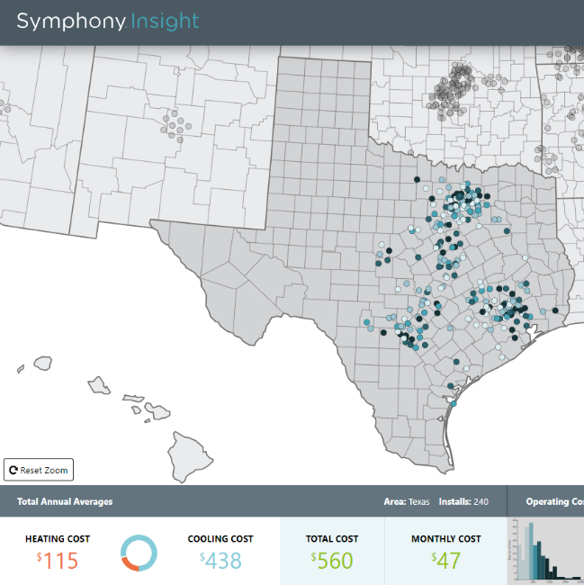
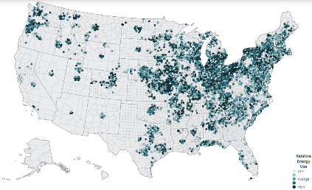
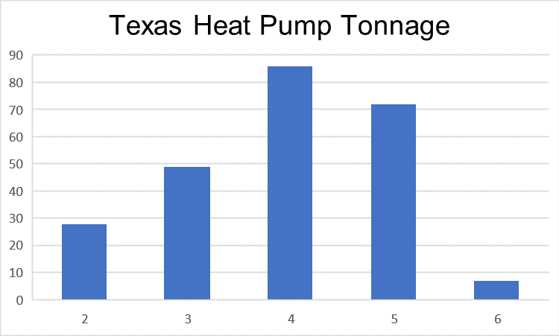

Slide 7
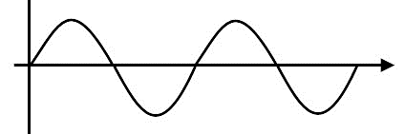
Ground Source Heat Pumps in Texas
Resiliency
Efficiency @ Extremes
Capacity @ Extremes
Lifecycle
Peak, Peak, & Peak
Summer ↓50%
Winter ↓75% (vs Resistance)
Balanced Load
Daily
Seasonally
Permanently
Fuel stability
>60% Electric
Resistance
Heat
Unaffected by weather
+ 30% Tax Credit Across the Board for 10 Years w/ Direct Pay

