Slide 1

Texas PACE answers the question, “How are we going to pay for it?”
TX-PACE is transforming how developers, owners, and contractors look at projects, proving that there is a clear path forward for energy efficiency, distributed generation, water use reduction, and resiliency projects in existing buildings.

Slide 2

Advancing PACE
with
SPEER
www.TexasPACEAuthority.org

Slide 3
LOWER
Utility Costs
WHAT TX-PACE DOES
INCREASE
Net Operating Income
Bottom Line: Increased Building Value

Slide 4
What Contractors PITCH
Strong ROI – will save $5.6M over system life
Innovative – groundbreaking efficient technology
20-year warranties, proven expertise
Hedge against rising energy prices
Unparalleled tenant comfort

Slide 5
What the CFO/Owner HEARS…
X Where will I get the funding?
X What if I sell the building in 5 years?
X We only do 3-Year payback projects
X Good technology…but my tenant pays the energy bills
X Are these savings even real? I’ve been burned before…

Slide 6
Changing the Story
What if you could develop a solution that…
1. Provides 100% up front funding of all hard and soft costs?
2. Allows a 20+ Year repayment term = immediate income source
3. Allows transfer of obligation automatically on sale
4. Doesn’t tie up borrowing capacity
5. Requires savings to be validated by third party review

Slide 8
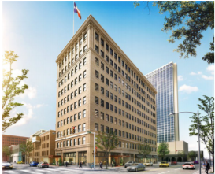
Barfield Building
City of Amarillo
Measures:
  LED lighting
  Building envelope
  Water efficiency
  Domestic hot water heating
State Historic Tax Credit financing: $9,050,551
Assessment Total: $ 6,447,609
Total Savings: electric energy: 73%
natural gas: 79%
water: 40%

Slide 9
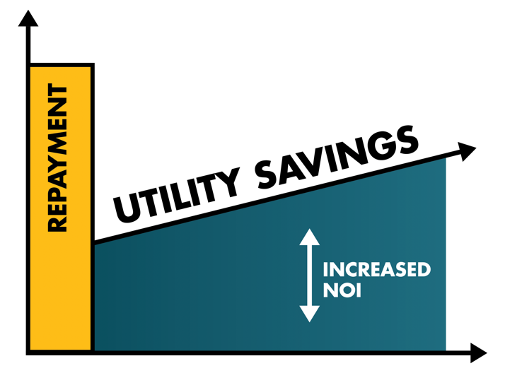

Short Financing term + Long ROI =
Cash flow Pain

Slide 10

REPAYMENT
LONG SIMPLE PAYBACK?
NO PROBLEM!
UTILITY SAVINGS
INCREASED NOI

Slide 11
Dallas Paint & Body
City of Dallas
Measures:
  LED lighting
  Solar PV
Assessment Total:
$ 74,000
92% Electric consumption reduction

Slide 12
WHAT IS TX-PACE?
Local Adoption economic development tool - Property assessment
100% long term, low cost financing
For energy efficiency, water conservation, distributed generation, and demand reduction (resiliency)
On commercial, industrial, and
multi-family (5+ units) properties
Notes:
New application of assessment districts:
-water and sewer service
-parks
-sidewalks
-lighting
-downtown renewal
-PACE

Slide 13
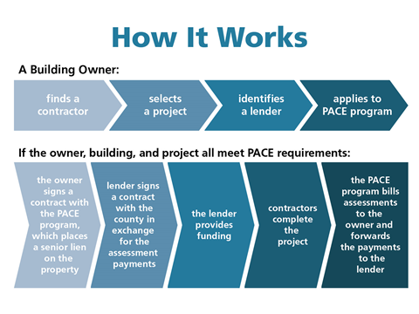
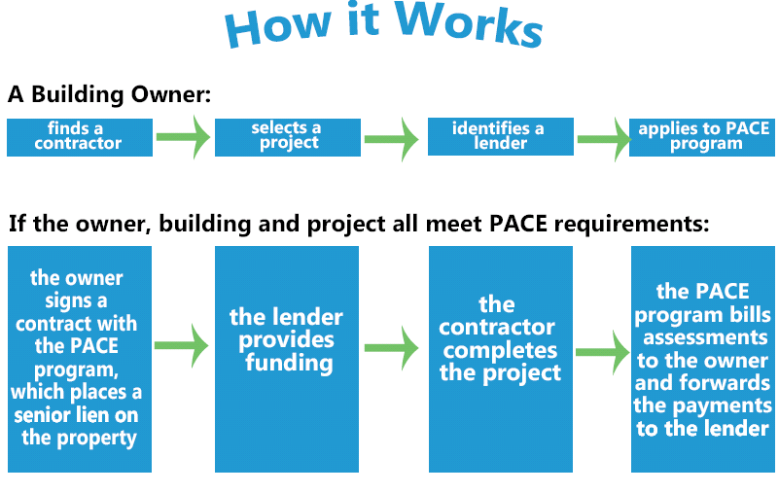

Slide 14


PACE IN A BOX
“PACE in a Box” is a toolkit of
recommendations and templates
for counties and municipalities to:
  Create uniform, user friendly, scalable, and sustainable PACE programs
  Administered by a nonprofit in a transparent manner, focused on gov’t tasks; free market with decision/power in hands of property owner

Slide 15


LOCAL GOVERNMENT
ACTION

Slide 16
WHERE IS PACE?

Slide 17
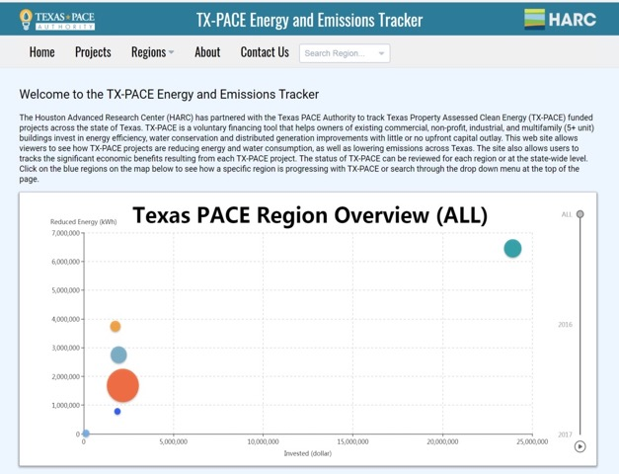

Houston Advanced Research Center’s TX-PACE Energy and Emissions Tracker
http://www.harcresearch.org

Slide 18
TRAVIS COUNTY –
TEXAS’ FIRST PACE PROGRAM, APRIL 2015

Slide 19
BASTROP COUNTY – SEPT. 2018

Slide 20
AACOG SERVICE AREA

Slide 21
2018 Project Savings
Property Name | 2018 Savings
 | Electricity Consumption | Water Consumption | Natural Gas Consumption
Elgin | 26%
Barfield | 73% | 60% | 79%
Dallas P&B | 92%
Softex | 47%
Cielo Vista | 48% | 20%
Average | 57% | 40% | 79%

Slide 22
ANNUAL TX-PACE INVESTMENT

Slide 23
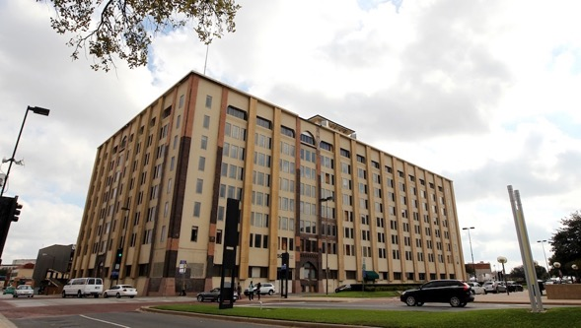
Butler Brothers Building Dallas
Measures:
HVAC
Lighting
Insulation
Roofing
Glazing
Plumbing
Irrigation
Exterior Waterproofing/Plaster
Assessment Total: $24 Million
Annual Savings: 40% energy reduction
700,000 gallons of water; 3,500 metric tons CO_{2e}

Slide 25
1225 N Loop, Houston
Built 1984
PACE Project:
Assessment Total:
$1.3 Million
Utility Incentives:
$30,000
Term: 20 years
Annual Savings:
38% energy reduction
Measures:
2 Chillers
Building Automation
LED Fixture Upgrade
Notes:
PROJECT FINANCING
Total Assessment: $1,304,352
Utility Incentives: $30,000Term: 20 years
BUILDING DETAILSSquare footage: 200,418Year Built: 1984

Slide 26
Cash Flows

Slide 27
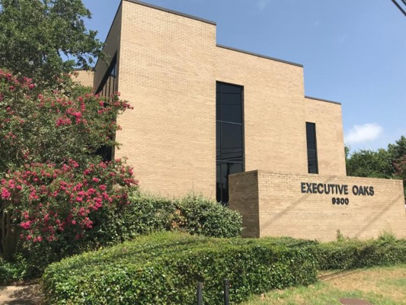
SOFTEX HEADQUARTERS
Built 1985
$291,000 PACE Investment
188,291 kWh Saved Annually
Measures:
  HVAC
  Roof
  Thermostats
  Solar
First office building in Travis County
First minority owned PACE project in Travis County

Slide 28
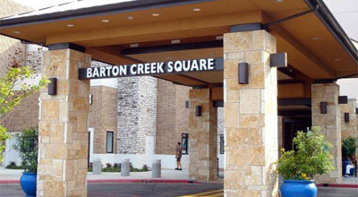
Simon Property Group
6 projects to date: El Paso, Hays, Travis,& Williamson Counties, & City of Houston
ROUND ROCK OUTLETS
Measures:
HVAC
Lighting
Water
Assessment total: $10 Million

Slide 29
Family Elder Care
Travis County
Measures:
63 kW PV
Cool Roof
Assessment Total: $260,000
Annual Savings: $20,000

Slide 30
Elgin General Store
Bastrop County
Measures:
  Solar PV
USDA REAP Grant & Oncor Incentives: $62,000
Assessment Total: $ 120,000
Total Savings: 26%; 91,081 kWh
1st local bank funded TX-PACE project (Frontier Bank)

Slide 31
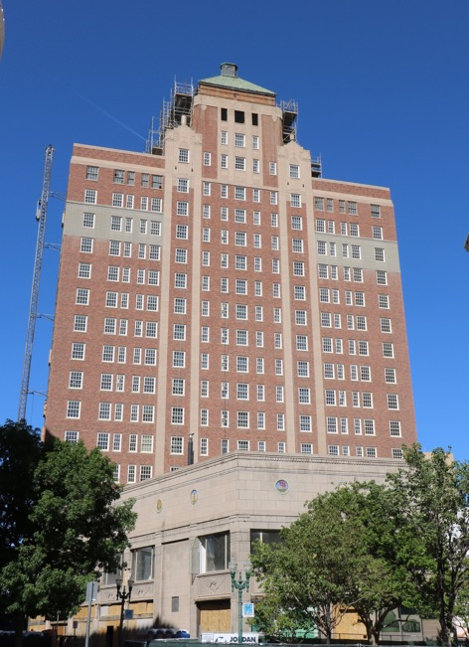
Plaza Hotel
El Paso County
PACE Assessment:
$9.2 million
Annual Savings:
1,488,687 kWh
770,100 Gallons water

Slide 32
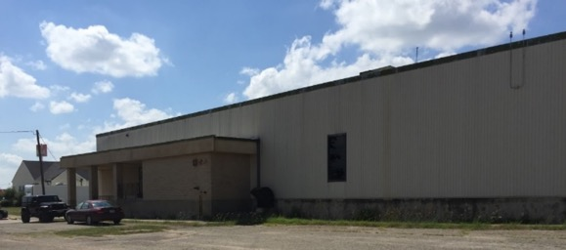
R.J. Liebe Company
Navarro County
Measures:
HVAC
Lighting
Investment: $325,000
187,000 annual KWh
60 – 80 new, permanent manufacturing jobs

Slide 33
Fort Worth’s 1921
XTO Energy Headquarters
to be Kimpton Hotel
Assessment: $5.8 million
HVAC
LED Lighting
Nat. gas water heater
Annual savings:
Over 2,000,000 kWh
Almost 15,000 BTU

Slide 34
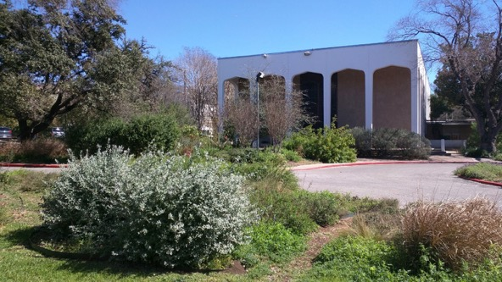
Congregation Beth Israel Austin
Measures:
Boilers
Chillers
Window Film
BAS Controls
Assessment Total: $450K
Annual Savings: $40,000

Slide 35
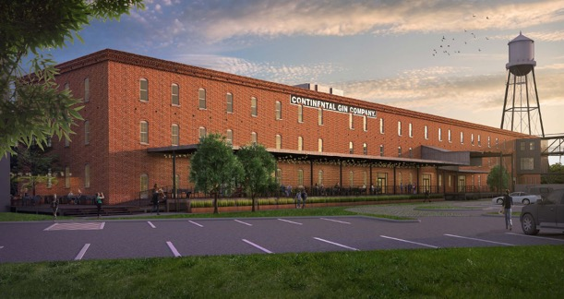
CONTINENTAL GIN BUILDING
Deep Ellum, Dallas
Assessment: $5,250,000
Roofing
Glass/Glazing
Mechanical/HVAC
Lighting, Solar
Ext. Walls, Elevators
Utilities

Slide 36
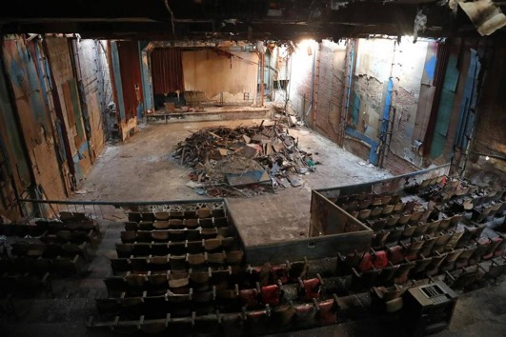
ISIS THEATER –
Cowtown, Fort Worth
$2,383,000
Envelope, etc. & Water

Slide 37
PACE is a WIN-WIN-WIN
Property Owners – lower utility bills, energy independence, energy efficiency, property value increase
Contractors – source of increase in business, more local hiring, best practices, keeping up with technology advancements
Lenders – new loans, steady & stable process, fully collateralized, Tax Assessment lien position, improved asset value
State of Texas – reduced peak demand, improved grid loading, distributed generation as resilient power source, improved air quality, better water conservation
Communities – increased economic development and jobs, improved building infrastructure, more appealing building stock
Notes:
What does “open market” mean?
Who is the administrator’s client?
Who gets to play in the local economy you are creating?

Slide 38
RESOURCES: https://comptroller.texas.gov/programs/seco/funding/pace.php https://pace.harcresearch.org www.TexasPACEAuthority.org www.KeepingPACEinTexas.org www.PACENation.us

Slide 39

Hon. Bruce Elfant, Travis County Tax Assessor Collector and Voter Registrar
Adena Lewis, Bastrop County Director of Tourism and Economic Development
John Clamp, AACOG CFO
Charlene Heydinger, Texas PACE Authority
President
www.TexasPACEAuthority.org
POWERED BY:

