Slide 1
Local Options for Above Code Programs

Slide 2
Residential Energy Codes Improving Faster

Slide 3
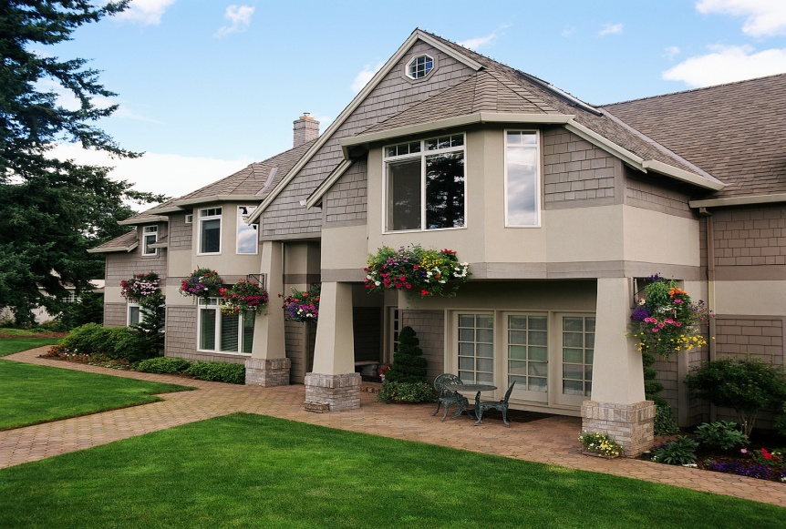
Pick the “Energy Efficient and Green” Home

Slide 4
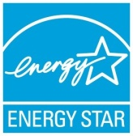
The “Green” Home
You tell by the
Certification
OR

Slide 5
What does it all mean?

Slide 6
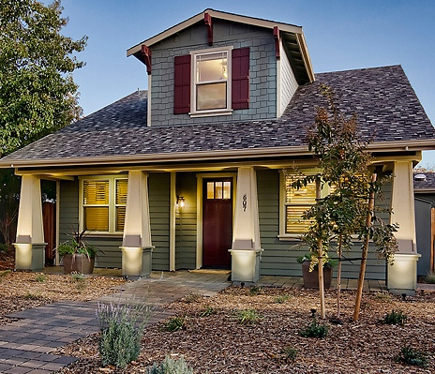
Water Efficiency
Lot Design
Resource Efficiency
Indoor Air Quality
Energy Efficiency
Operation & Maintenance

Slide 7
EPA Indoor airPLUS ⎯ Key Features and Benefits

Slide 8
• Moisture Control: Moisture problems can lead to mold and other biological pollutants that can negatively impact health. With Indoor airPLUS, builders use a variety of moisture control features designed to minimize these risks, including improved control of condensation and better roof, wall, and foundation drainage. • Pest Management: Residue from pests such as rodents and cockroaches are known to trigger allergy and asthma episodes. With Indoor airPLUS, builders provide a first-line defense against these problems by fully sealing, caulking, or screening likely pest entry points. When these physical barriers are combined with proper pest management techniques, fewer pesticides may be needed.
airPLUS FEATURES AND BENEFITS

Slide 9
• Heating, Ventilating, and Air-Conditioning (HVAC): Poorly designed and installed HVAC systems can lead to comfort and air quality problems. Homes with the Indoor airPLUS label include properly engineered systems, improved duct and equipment installation, improved filtration, and whole-house and spot ventilation to dilute and remove indoor pollutants. Builders also inspect air-handling equipment and ductwork to ensure they are clean and free of debris and provide adequate air-flow. • Combustion Venting: Homes with the Indoor airPLUS label can help protect residents from potential exposure to combustion pollutants by requiring heating equipment that cannot leak combustion gases inside the home, installing carbon monoxide alarms in each sleeping area, and taking steps to prevent pollutants in the garage from entering the house.
airPLUS FEATURES AND BENEFITS

Slide 10
• Building Materials: The types of materials that builders choose and the way they manage them during construction can affect a home’s indoor air quality. Builders following the Indoor airPLUS specifications reduce sources of pollutants by protecting materials stored on-site from weather damage, using materials with reduced chemical content, and ventilating homes prior to move-in to help improve indoor air quality. • ENERGY STAR: Only ENERGY STAR qualified homes are eligible to earn the Indoor airPLUS label. • Third party verification
airPLUS FEATURES AND BENEFITS

Slide 11
WaterSense ⎯ Key Features and Benefits

Slide 12
WaterSense is a partnership program sponsored by the U.S. Environmental Protection Agency that seeks to protect the future of our nation’s water supply by offering people a simple way to use less water. WaterSense labeled homes not only feature quality products and workmanship, they are designed to use 20 percent less water than the average new home. Living in a house that has earned the WaterSense label allows you to do more using less water and feel good about preserving water for future generations.
WATERSENSE FEATURES AND BENEFITS

Slide 13
• Hot Water—When You Need It Efficient hot water delivery systems are designed to bring you hot water faster, so you don’t waste water—or energy—while you’re waiting for a hot tub or scrub. With this feature alone, you can save enough electricity to power your television for a whole year. • Bathroom You can have a luxurious bathroom with Water­Sense labeled plumbing fixtures that have been independently certified to perform well and save nearly 5,000 gallons of water per year compared to the average new home’s bathroom.
WATERSENSE FEATURES AND BENEFITS

Slide 14
• Kitchen If a dishwasher and clothes washer are installed in your home, they will be ENERGY STAR® qualified models that use less energy and water while handling your toughest loads. • Landscaping Landscaping is designed to create a healthy, beautiful front yard that uses less water. Plantings will thrive in your local climate with minimal maintenance and less frequent watering. • Third party verification
WATERSENSE FEATURES AND BENEFITS

Slide 15
DOE Challenge Home ⎯ Key Features and Benefits

Slide 16
DOE Challenge Home- With ENERGY STAR ensuring complete building science, make homes ready for Net-Zero performance by adding proven technologies and practices. Incorporates - Energy Star v3, EPA's Water Sense (Indoor Spec), EPA's Indoor airPLUS (IAP), plus Renewable Energy Ready Home (RERH) with Solar PV / Solar Thermal [where applicable], IBHS Fortified Home (encouraged), and Quality Management (encouraged): • Renewable Energy Ready Home (RERH) with Solar PV / Solar Thermal [where applicable], IBHS Fortified Home (encouraged), and Quality Management (encouraged) • Strong Heritage: Challenge Home technical specifications are derived from world- class research conducted under the U.S. DOE Building America Program and every home meets ENERGY STAR for Homes Version 3 requirements. Look for the most effective and proven innovations in every labeled home.
DOE CHALLENGE HOME FEATURES AND BENEFITS

Slide 17
• Sustained Value: Since you only have one chance to build quality into a new home, every Builders Challenge qualified home is constructed to meet forthcoming code requirements. It’s great peace-of-mind to know the largest investment of a lifetime won’t be obsolete in a few years! • No or Ultra-Low Utility Bills: Every Builders Challenge Qualified Home is so energy efficient, a small solar system can often offset most, or all, of your utility bills. Look for important details that can save $1,000’s of dollars installing a solar system in the future. Enjoy watching your home’s value rise as utility rates steadily increase. • Breathe Better: Since we spend about two-thirds of our time each day inside our homes, every Builders Challenge Qualified Home has a comprehensive package of measures that control dangerous pollutants, provide continuous fresh air, and effectively filter the air you breathe. Now you can provide a healthier home for your family.
DOE CHALLENGE HOME FEATURES AND BENEFITS

Slide 18
• Water Smart: Every Builders Challenge home is equipped with the latest hot water distribution technology and often water saving fixtures. Save as much as 10,000 gallons or more wasted water down the drain each year and enjoy near-instant hot-water. Save water with no sacrifice in performance. • Engineered to Last: Comprehensive water protection and superior air-flow management can eliminate moisture-related problems. In addition, builders are encouraged to include regionally appropriate disaster-resistant construction practices. A home built to Builders Challenge quality standards is designed to last hundreds of years. • Future Performance Available Today: The U.S. DOE believes the advanced levels of affordability, comfort, quiet, health, durability, and quality delivered in your Builders Challenge Qualified Home is where all housing is headed in the future. Now you can feel confident before making such a large purchase decision.
DOE CHALLENGE HOME FEATURES AND BENEFITS

Slide 19
Environments for Living ⎯ Key Features and Benefits

Slide 20
ENERGY EFFICIENCY • Tight Construction-Special framing techniques such as a continuous air barrier and sealing of penetrations help reduce internal leaks and drafts. • Improved Thermal Systems Enhanced insulation techniques help to minimize voids and gaps, and higher thermal properties (R-value) add to energy efficiency. • Right-Sized HVAC "Right-sized" heating and cooling systems and sealed air ducts help equipment work efficiently.("Right-sized" refers to the process of determining which HVAC system should be used in any particular structure.) • Guaranteed Performance-Written guarantees* are issued to homeowners on the amount of energy used for heating and cooling, and comfort.
EFL – ENERGY SAVINGS - FEATURES AND BENEFITS

Slide 21
ENERGY EFFICIENCY (CONTINUED) • Low-E Windows-Low "emissivity" windows have protective coatings to help keep heat in during winter and out during summer. • Energy-Efficient Lighting-At least 60% of all hard-wired lights must be compact fluorescent or LED, reducing overall home energy consumption. • Energy-Efficient Appliances-ENERGY STAR® qualified appliances such as refrigerators and clothes dryers, dishwashers and efficient water heaters help conserve energy.
EFL – ENERGY SAVINGS - FEATURES AND BENEFITS

Slide 22
DURABILITY • Internal Moisture Management-Vents, pressure balancing, fresh air ventilation and "right-sized" HVAC equipment work to reduce moisture from daily activities like cooking and showering. • Tight Construction-Air barrier continuity and air tightness reduce the potential for moisture to enter the building envelope. • Improved Thermal Systems-Program requirements such as low-e windows and insulation installed in contact with the air barrier reduce the potential for moisture build-up.
EFL –DURABILITY - FEATURES AND BENEFITS

Slide 23
DURABILITY (CONTINUED) • Optimum Value Engineering-Special framing techniques reduce lumber requirements and material use, while maintaining structural integrity. • Paint Durability-Interior paints that meet a minimum 400 scrubs (ASTM D4060-07), add to product longevity and can reduce future material needs.
EFL –DURABILITY - FEATURES AND BENEFITS

Slide 24
INDOOR ENVIRONMENTAL QUALITY: • Fresh Air Ventilation-Fresh air ventilation systems deliver filtered fresh air to help reduce dust, odors and indoor contaminants for improved indoor air quality. • Internal Moisture Management-Vents, pressure balancing, fresh air ventilation and "right-sized" HVAC equipment work to reduce moisture in multiple ways. • Air Pressure Balancing-Balanced air pressure throughout the home results in more-even temperatures and reduces the potential for condensation build-up. • Combustion Safety-Combustion appliances in conditioned spaces are sealed or power-vented to help avoid build-up of carbon monoxide, and vent-free fireplaces are not allowed. CO detectors are required in all homes.
EFL –INDOOR AIR QUALITY - FEATURES AND BENEFITS

Slide 25
INDOOR ENVIRONMENTAL QUALITY: (CONTINUED) • Enhanced Filtration Systems - Air filters with a MERV (Minimum Efficiency Reporting Value) of 8 or greater, or an approved electronic air cleaner, provide extra protection from contaminants. • Paint - Using paints with low levels of VOCs (Volatile Organic Compounds) reduces indoor pollutants. • Carpet - Carpets carrying the Carpet Rug and Institute (CRI) Green Label® for low VOC emissions strictly limit substances that can off-gas. • Cabinetry - Cabinets constructed from composite panels that meet the standards of the Kitchen Cabinet Manufacturers Association Environmental Stewardship Program (www.kcma.org), and the Composite Panel Association Environmentally Preferable Product Specification (CPA 03-08) (www.pbmdf.com).
EFL –INDOOR AIR QUALITY - FEATURES AND BENEFITS

Slide 26
WATER SAVINGS • Low-Flow Faucets - Kitchen sink and lavatory faucets that conserve water help reduce overall internal household water consumption. • Low-Flow Showerheads - Showerheads using the latest technologies can help save water without compromising performance. • High-Efficiency Dishwashers • ENERGY STAR® rated dishwashers use less water and add to overall household water savings.
EFL –WATER SAVINGS - FEATURES AND BENEFITS

Slide 27
WATER SAVINGS (CONTINUED) • High-Efficiency Toilets • Water efficient toilets that meet specific performance criteria help reduce water use in the home. • High-Performance Clothes Washers • ENERGY STAR® qualified clothes washers that meet specific water efficiency metrics help to save on household water use.
EFL –WATER SAVINGS - FEATURES AND BENEFITS

Slide 28
Green Built Texas ⎯ Key Features and Benefits

Slide 29
• Site Management & Waste Reduction - Green Built Texas homes incorporate efficient site management and waste reduction practices on the jobsite aimed at reducing the environmental impact of the home while under construction. These practices and principles include tree preservation and protection, recycling measures and storm water control systems designed for the site. • Water Efficiency - Preserving water resources is important to all Texans, and Green Built Texas homes are designed to conserve water both indoors and out. More efficient water delivery systems indoors combined with drought-tolerant landscaping choices and smart irrigation systems outdoors help extend current water resources. Buyers should discuss other GBT offerings with their builder such as rainwater catchment and additional water saving appliances to maximize water savings.
GREEN BUILT TEXAS - FEATURES AND BENEFITS

Slide 30
• Indoor Air Quality - Following energy efficiency, consumers often cite the home’s indoor air quality as the most important feature of their home. Sensitivities to chemicals that can be emitted from construction and home furnishing materials are becoming more common and Green Built Texas homes aim to mitigate the effects of potential contaminants. Through proper design, ventilation and filtering the source of contaminates can be controlled, diluted and/or captured. This aspect is particularly important in Texas where high levels of allergens and pollen are often reported. • Energy Efficiency-Energy consumption is of paramount concern to today’s homebuyers due to financial and far-reaching environmental impacts. In addition, each home consumes energy year after year, meaning that the environmental impacts associated with that use accrue over time. Therefore, energy conservation is an integral part of all Green Built Texas homes.
GREEN BUILT TEXAS - FEATURES AND BENEFITS

Slide 31
National Green Building Standard ⎯ Key Features and Benefits

Slide 32
• A comprehensive, credible program designed specifically for single and multifamily homes. An ANSI approved rigorous yet attainable and affordable option for builders and developers. • Healthy Homes - Limits moisture problems that attract pests and contribute to mold, provides a level of fresh air that improves indoor living, and reduces pollutants through smart selection and fresh air ventilation. • Operating Efficiencies - Creates energy and water savings through strategic equipment selection, sizing, and sound building principles. Controls maintenance costs through durable building products and techniques. The NGBS also provides meaningful savings for residents and operators. • Sustainable lifestyles - NGBS promotes walkability, limits time burden for home or building maintenance, and provides benefits to the community.
NGBS - FEATURES AND BENEFITS

Slide 33
LEED ⎯ Key Features and Benefits

Slide 34
LEED-Nationally and Internationally recognized, the LEED Rating System promotes sustainability in all aspects of the building process by measuring the performance of a home. LEED takes into consideration the following environmental categories: • Innovation and Design – LEED encourages attention to sustainable home design and performance that are shown to produce quantifiable human and health benefits and improve long term durability. • Locations and Linkages – Credits in this category are awarded for sustainable land-use, which includes: minimizing forest and farmland fragmentation, constructing with a need for fewer infrastructures, and discouraging dependence on personal automobiles.
LEED - FEATURES AND BENEFITS

Slide 35
• Sustainable Sites – This category supports responsible site design. Points are given for erosion control, minimized soil disturbance, native landscaping, surface water management, and pest control. • Water Efficiency – LEED promotes the installation of water efficiency measures in new homes, which can reduce water usage by at least 30%. This can be done through water reuse, attention to irrigation systems, and the use of low flow, high efficiency fixtures. • Energy and Atmosphere – This category aims to minimize energy use in the home and emission release into the air. This is done by encouraging builders to improve the energy performance of their homes and to invest in energy- saving and climate friendly technologies.
LEED - FEATURES AND BENEFITS

Slide 36
• Materials and Resources – Building material choice affects the environmental footprint of a home due to the extraction, processing, transportation, and disposal that they require. This category directs builders in the selection of environmentally-preferable materials, utilizing material-efficient framing, and responsible waste management. • Indoor Environmental Quality – LEED strategies aim to prevent indoor air quality problems from arising and improve the air quality and comfort of the homes they build. This is done through source removal, source control, and dilution. It is generally much less expensive to take this approach than to identify and solve them after they occur. • Awareness and Education – Green construction training of homebuyers, building managers, tenants, and the public body is a necessary component to ensure that the full benefits of LEED measures are achieved.
LEED - FEATURES AND BENEFITS

Slide 37
What is Green Built Gulf Coast
ANSI Approved Jan 2009
Collaboration between ICC and NAHB
First green rating system to become approved consensus standard
Responds to legislators’ calls for Green benchmarks
Credibility= 100% third party verified
Provides one national, industry-vetted definition of “Green”

Slide 38
What are the Differences Between GBGC and NAHB Programs
Administration of Participants
Verification Process
Reporting Process
Cost
Scoring Tool

Slide 39
How To Participate in GBGC
Builder Agreement
Verifier Agreement
Developer Agreement
Remodeler Agreement
Associate Agreement

Slide 40
Utility Guarantees
differential among energy efficient homes

Slide 41
• In many cases lower operating cost and lower total cost of home ownership. • More Comfortable - Comfort is a combination of temperature, humidity, air movement and is personal in nature. While there is no combination of temperatures that will be considered perfect for all potential occupants, building science tells us that one key to comfort is "right-sizing" of the HVAC systems. Research and shows that the vast majority of population is comfortable at a temperature range of 75 degrees to 78 degrees and 45% to 55% relative humidity. “Right-sizing” of equipment can help control temperature and humidity. • Market place differentiator - Builders can differentiate themselves in the marketplace by offering voluntary utility use guarantees. A way for builders to communicate the message of energy efficiency.
UTILITY GUARANTEES
•

Slide 42
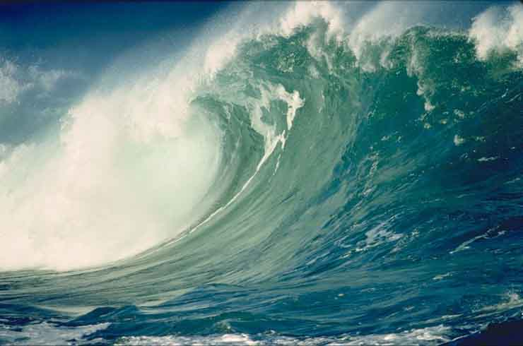
Conclusion

